Slide 1
ANNs History Activation Functions Architectures Perceptron Algorithm

Slide 2
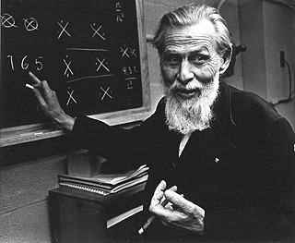
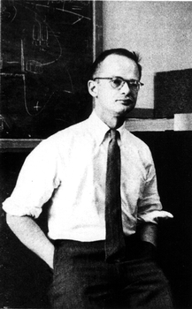
Warren S. McCulloch
Walter H. Pitts Jr.
Designers of the first neural network.
McCulloch (neuroscientist) and Pitts (logician) tried to understand how the brain could produce highly complex patterns by using many basic brain cells called neurons that are connected together.

Slide 3
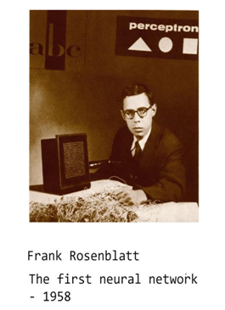
Rosenblatt known as the founder of Neurocomputing designed the first neural network called perceptron.
In 1977 Asociative memory model was developed by Finnish scientist Kohonen.
John Hopfield introduced Hopfield Net in his 1982 paper introduced concept of energy .
In 1986 the multi layer perceptron was proposed

Slide 4
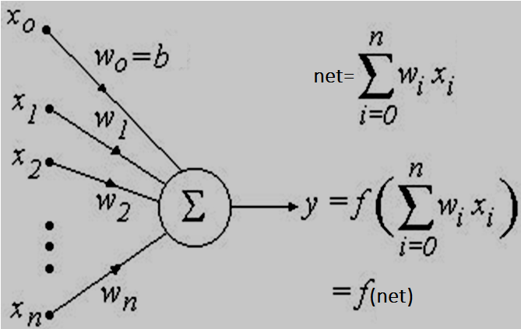
An artificial neuron is characterized by the parameters
θ = (w₁ ,w₂, . . . ,w_{n}, b, f)
f is the activation function.
The bias b can be treated as another “weight” by adding an input node x₀ that always takes the input value x₀ = +1 and setting w₀ = b.

Slide 5
The structure of ANN is composed of:
Activation Function (how neurons respond)
Architecture (topology of how the network is structured)
Learning Rule (how the weights of the connections change over time, w.r.t input, output and error).

Slide 6
Activation Function of ANN
A Neural Network without Activation function would simply be a Linear regression Model
Activation functions add to NN :
the ability to learn and model images, videos , audio , speech etc
2.the ability to Represent non-linear complex arbitrary functional mappings between inputs and outputs.

Slide 7
Properties of Activation Functions
Differentiable: all the activation functions in BPA (Back propagation algorithm) need to be differentiable
Computational Expense: Activation functions are applied after every layer and need to be calculated millions of times in deep networks. Hence, they should be computationally inexpensive to calculate.
Vanishing Gradient problem: If gradients shift towards zero ( vanishing gradient) , it takes much time to converge into the global optimum or it even can’t reach that point.
Monotonicity: Most of the activation functions are monotonic i.e either entirely non-decreasing or entirely non-increasing. Derivative of activation may not be monotonic

Slide 8
Two types of Activation Functions
Linear Activation Function
Non-linear Activation Functions

Slide 9
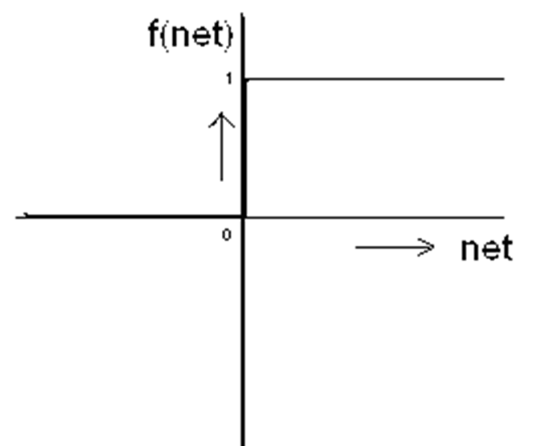

Unipolar Binary Step Function
Unipolar Threshold Logic Unit ( TLU)
f(net) =1 if net ≥0
=0 otherwise
A similar kind of thing happens in neurons in the brain (if excitation greater than inhibition, send a spike of electrical activity on down the output axon)

Slide 10
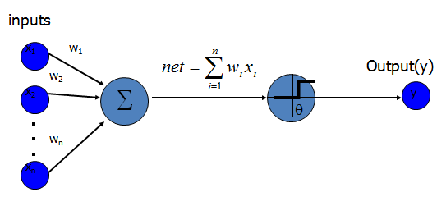
Unipolar Threshold Logic Unit (TLU)
1 if net≥ θ
y= 0 if net < θ
{
This activation function can be used in binary classifications
it can not be used in a multi-classes situation

Slide 11
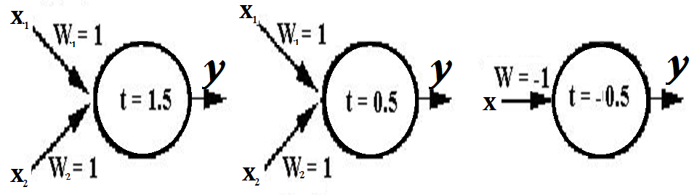
IDENTIFY GATES with binary input/output activation is unipolar TLU, SINGLE NEURON
AND
OR
NOT
net= x₁ +x₂ net>=0.5, y=f(net)=1
net<0.5,y= f(net)=0
net= -x
net>=0.5 ,y= f(net)=1
net<0.5, y=f(net)=0
net= x₁ +x₂ net>=1.5, y= f(net)=1
net<1.5, y=f(net)=0

Slide 12
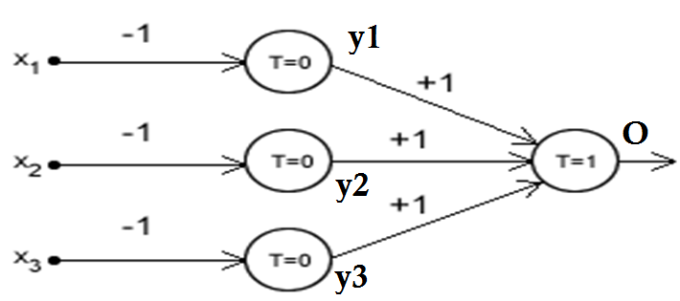
Inputs are binary, activation is unipolar TLU what function is it realizing FOUR NEURONS
net₁ = w₁ x₁ =-x₁ If net₁ >=0, y₁ =f(net₁ )=1; if net₁ <1, y₁ = f(net₁)=0
net₂ = w₂ x₂ =-x₂ If net₂ >=0, y₂ =f(net₂ )=1; if net₂ <1, y₂ = f(net₂)=0
net₃ = w₃ x₂ =-x₃ If net₃ >=0, y₃ =f(net₃ )=1; if net₃ <1, y₃ = f(net₃)=0
net₄ = w₁ y₁ + w₂ y₂ + w₃ y₃ = y₁ + y₂ + y₃
If net₄ >=1, O =f(net₄ )=1; if net₄ <1, O = f(net₄)=0
NAND GATE [ only 1,1,1, will give output as 0

Slide 13

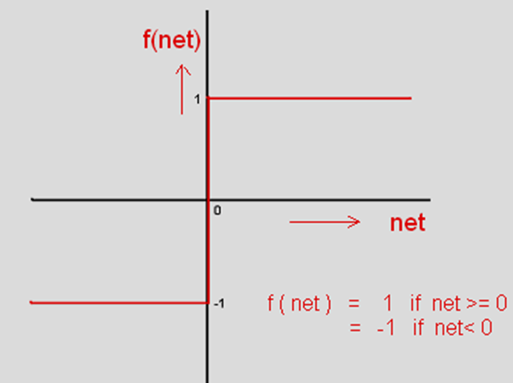
Bipolar Binary Step Function
Hardlims in Matlab
‘s’ stands for symmetric
slope is zero except at origin Not differentiable,

Slide 14
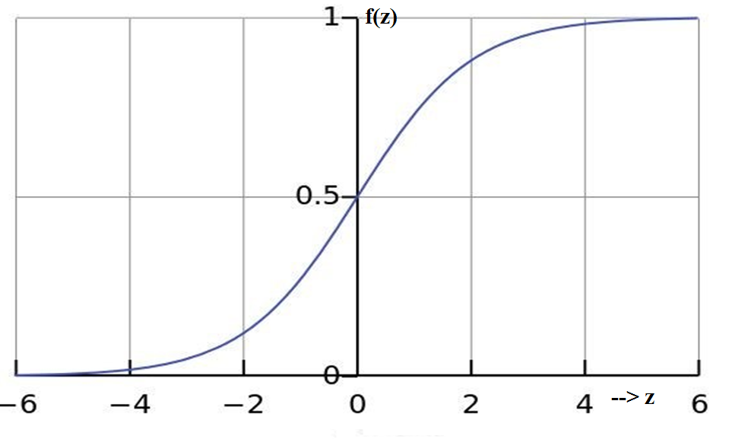
Log sigmoid Activation function : output varies between 0 and 1, sigmoid function s makes it unique for the binary classification problems
S –shaped curve

Slide 15
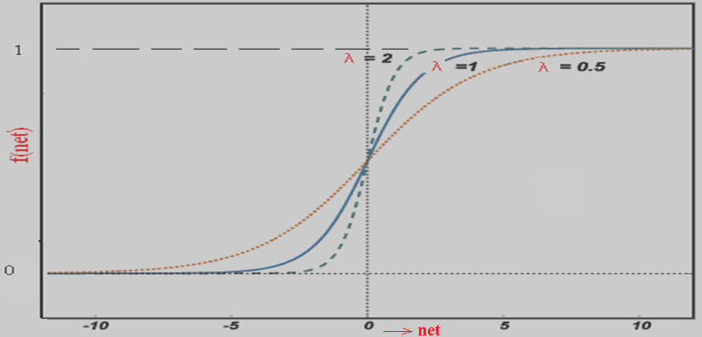

LOG SIGMOID ACTIVATION FUNCTION

Slide 16
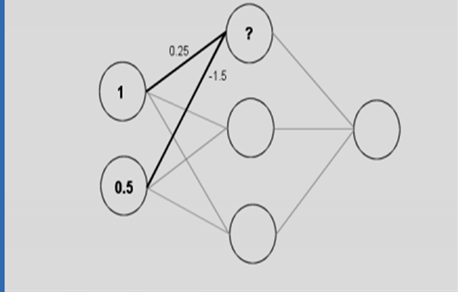
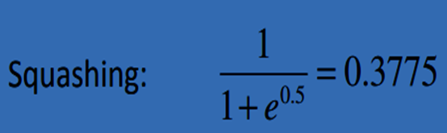
Calculate output of uppermost hidden node

Slide 17
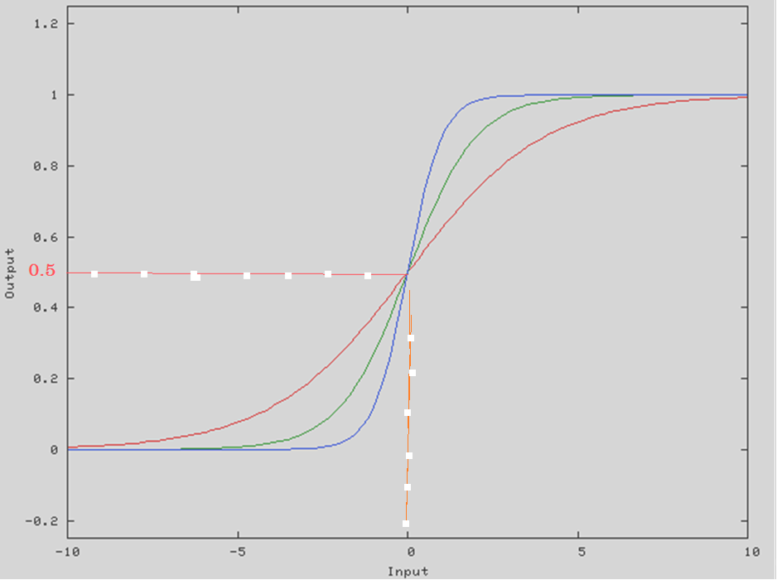
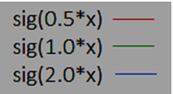
Can the sigmoid be adjusted left-or-right, making it centered on some other value than x= 0??

Slide 18
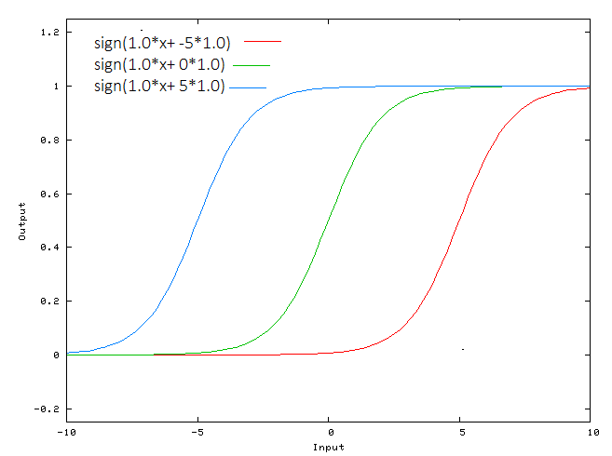
a bias value (-5/0/5)to sig with slope of 1 allows you to shift the activation function to the left or right, which may be critical for successful learning.

Slide 19
net=-10, f(net)=0.000045,
net=0, f(net)=0.5,
net=10, f(net)=0.99995
when the neuron's activation saturates at either tail of 0 or 1, the gradient at these regions is almost zero.
Sigmoids saturate and kill gradients.

Slide 20
if the initial weights are too large then most neurons would become saturated and the network will barely learn.
Pay extra caution when initializing the weights of sigmoid neurons to prevent saturation.
Sigmoid is especially used for models where we have to predict the probability as an output.
Since probability of anything exists only between the range of 0 and 1, sigmoid is the right choice.

Slide 21
Log Sigmoid - Not a zero-centered ( output can be either negative or positive) function (T/F)
Logsigmoid- the output is always positive so it is not a zero-centered function
similar to a situation where you are only allowed to move left and forward, not allowed to move right and backward then it is very hard to reach the desired destination.
Because of e^{x}, it is computationally-intensive which makes convergence slower.

Slide 22

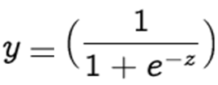
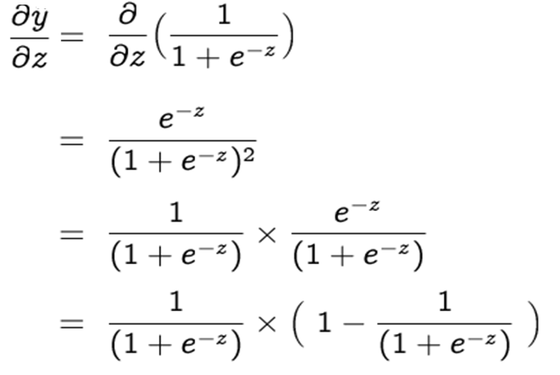

CALCULATE
And express it in terms of y

Slide 23
Derivative of sigmoid can be expressed in terms of function itself - so computationally easy to perform.

Slide 24
At what value of net, Derivative of log-sigmoid activation function is maximum and what is its value
dy’/y= 0 implies ⇒1 – 2y = 0 , i.e. y = 1/2
derivative is maximum at y= =1/2= 1/1+e^{-net} ⇒ net =0
and maximum value of slope is
y’= y(1-y)= ½(1-1/2)=1/4=0.25
If λ=2, maximum value of derivative y’ will be 2(1/4)=1/2

Slide 25
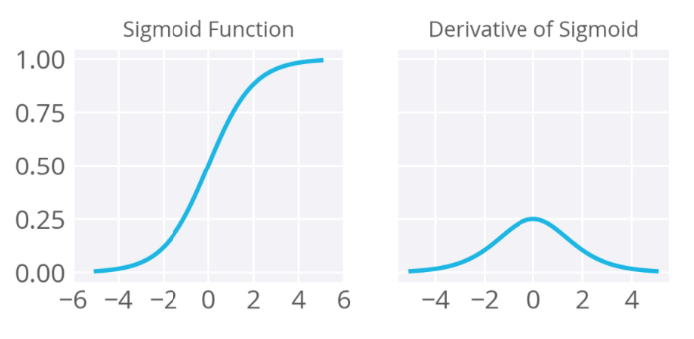
The function is monotonic while its derivative is not

Slide 26
The maximum value of the derivative of sigmoid is 0.25 and the minimum is 0.
The maximum value is less than 1. Many times multiplication of smaller numbers results in a very small number (close to 0).
So this is how vanishing gradient is happening in a neural network (NN) with sigmoid activations.
If NN is deep and all activations are sigmoid, then there is a very high chance of vanishing gradient.

Slide 27
For the BPA in a neural network, it means
Errors multiplied by the derivatives of activation function will be squeezed by (at least) a quarter at each layer.
SO deeper your network is, more knowledge from the data will be "lost".
Some "big" errors from the output layer might not be able to affect the synapses weight of a neuron in a relatively shallow layer much ("shallow" means it's close to the input layer).
Due to this, sigmoids have fallen out of favor as activations on hidden units in DNNs.

Slide 28
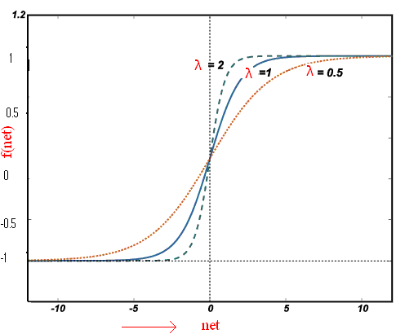
Tan Sigmoid activation function
output is zero centered because its range is between -1 to 1.

Slide 29
The tansigmoid/tanh function is mainly used for classification between two classes.

Slide 30
Find f ’(net) w.r.t. net in terms of y
For tanh
derivative is (1-y² )

Slide 31
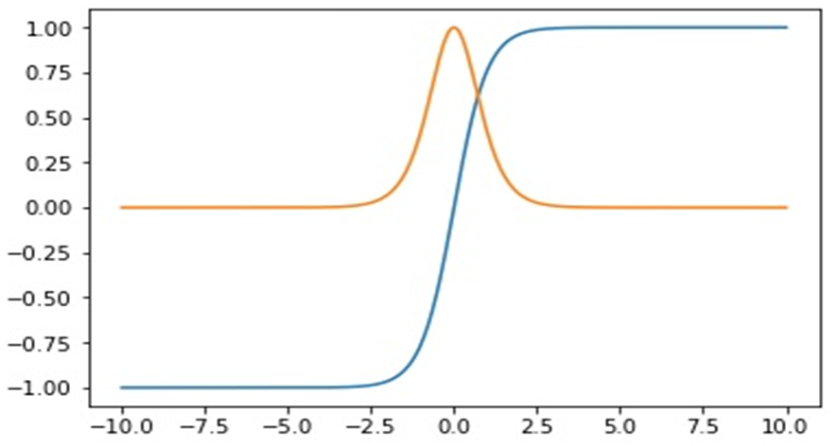

Legend ?, what do blue and yellow curve stand for ?
The gradient is stronger for tanh than sigmoid ( derivatives are steeper).
Tanh also has the vanishing gradient problem.

Slide 32
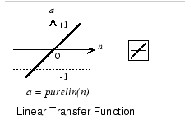
Linear Activation function
y = f(net)= c*net, y’=f’(net) = c,
if c=1, f’(net)=1

Slide 33
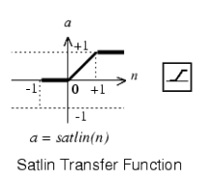
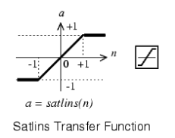

Slide 34
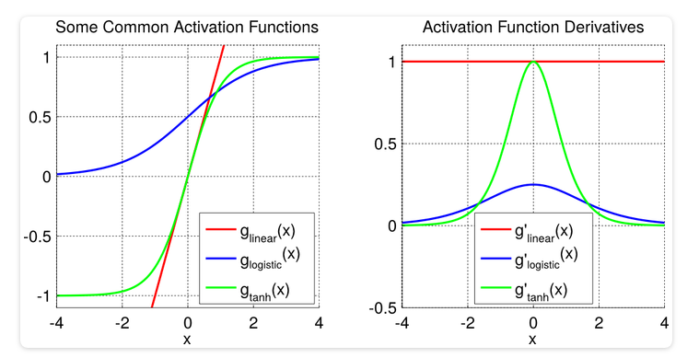
With linear activation function changes made in back-propagation will be constant which is not good for learning

Slide 35
Ex: The input to a SINGLE NEURON is 2.0, its weight is 2.3, and bias is -3.0
What is the net input to activation/transfer function
What is neuron output if activation function is
(i) Hard limit[0/1] (ii) linear (iii) logsigmoid
Net input is : 2x(2.3) – 3 = 1.6

Slide 36
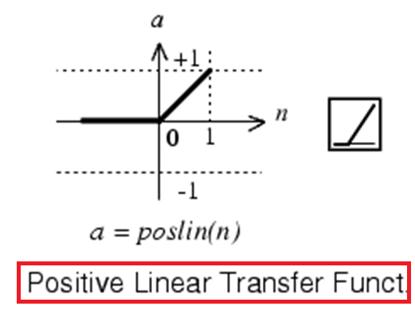
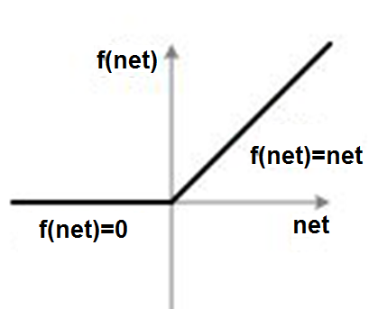
Currently the most popular activation function for neural networks is the rectified linear unit (ReLU), which was first proposed for restricted Boltzmann machines (Nair & Hinton, 2010)
f(net) = max(0,net) i.e
If net < 0 , f(net) = 0 and
if net >= 0 , f(net) = net.

Slide 37
ReLu Activation Function
Easy to compute.
Does not saturate for the positive value of the weighted sum of inputs.
ReLu is a zero-centered function. (T?F)
False
defined as max(0, w₁ x₁ + w₂ x₂ + …+ b)
non-differentiable at zero; and the value of the derivative at zero can be arbitrarily chosen to be 0 or 1
may suffer from the “Dying ReLU problem”.

Slide 38
Dying ReLU problem: Any negative input given to the ReLU activation function turns the value into zero, not mapping the negative values appropriately.
ReLU neurons can sometimes be pushed into states in which they become inactive for essentially all inputs.
In this state, no gradients flow backward through the neuron, and so the neuron becomes stuck in a perpetually inactive state and "dies".
This is a form of the vanishing gradient problem.

Slide 39
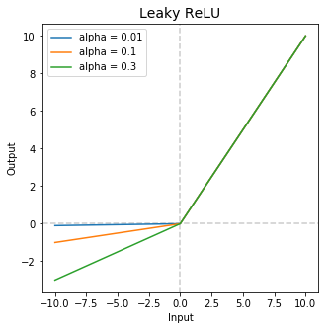

Slide 40
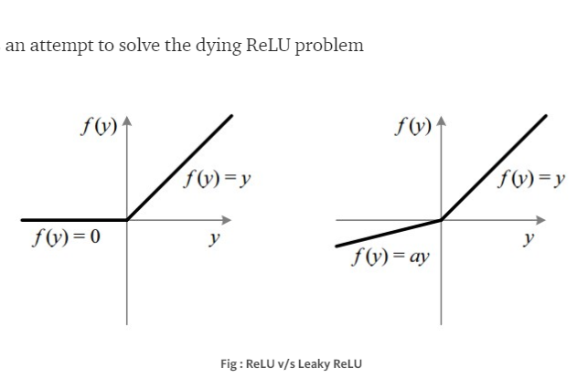
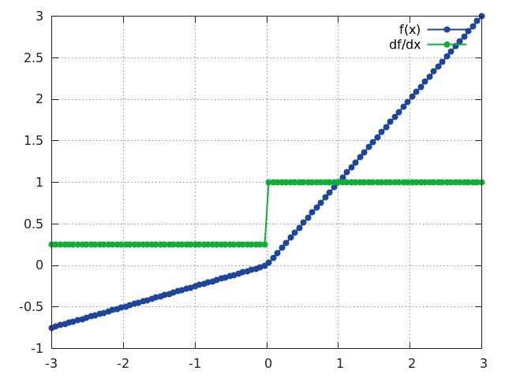

Slide 41
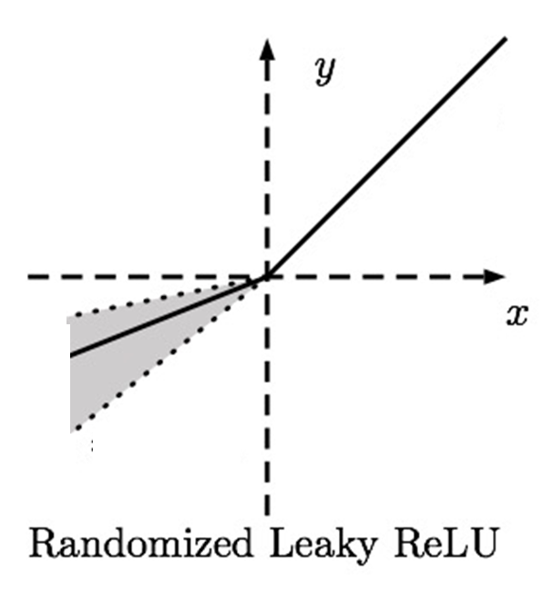
When α is not 0.01 then it is called Randomized ReLU
In Keras, Leaky ReLu has default value of α= 0.3

Slide 42
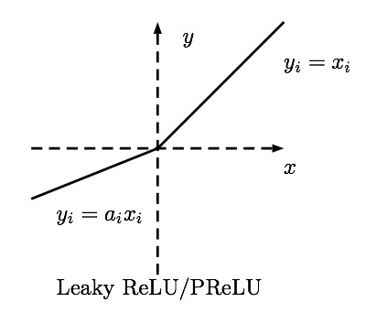
Parametric ReLU has the same advantage with the only difference that the
slope of the output for negative inputs is a learnable parameter
while
In Leaky ReLU, it's a fixed hyperparameter.

Slide 43
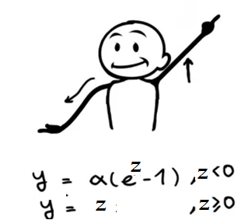
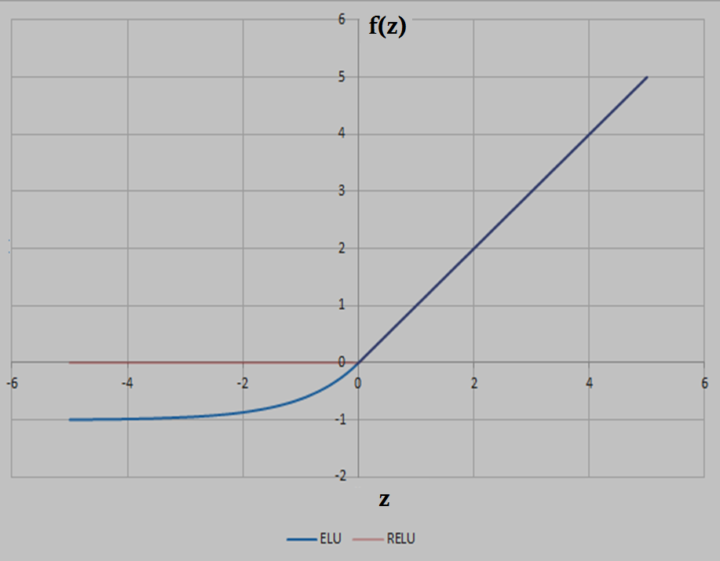
Exponential Linear Unit (ELU)
z is net and α is positive,
as z becomes large, value converges to( -α)
Draw f(z) and f’(z) for α =1/8, 1/2, 1, 2, 8

Slide 44
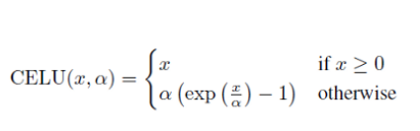
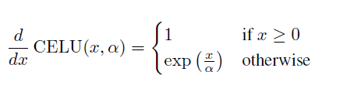
Continuously Differentiable Exponential Linear Units(CELU)
Draw f(x) and f’(x) for α =1/8, 1/2, 1, 2, 8

Slide 45
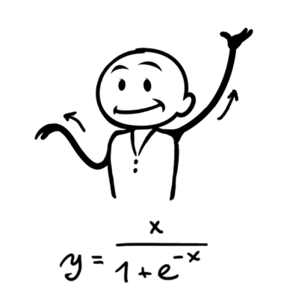

Swish is a new, activation function discovered by researchers at Google.
In experiments on ImageNet with identical models running ReLU and Swish, the new function achieved top -1 classification accuracy 0.6-0.9% higher.

Slide 46
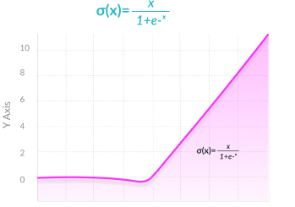

Slide 47
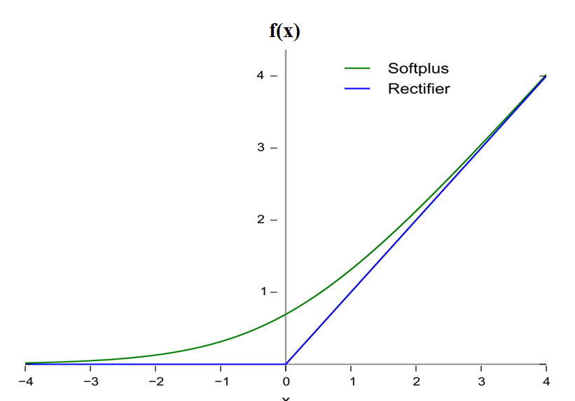
A smooth approximation to the rectifier is the analytic function called softplus function

Slide 48
Both the ReLU and Softplus are largely similar, except near 0 where the softplus is enticingly smooth and differentiable.
Calculate differential of Softplus
Both function and its derivative are monotonic

Slide 49
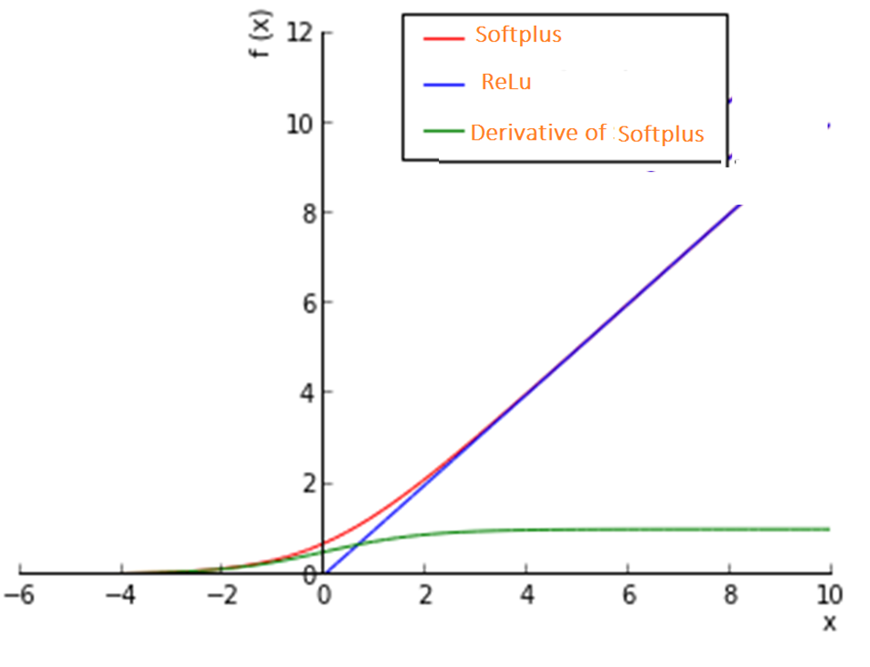
Red : Soft plus

Slide 50
ReLu- Rectified Linear units : it had 6 times improvement in convergence from tanh function.
it is very simple and efficient .
it avoids and rectifies vanishing gradient problem.
Almost all deep learning Models use ReLu
In Classification problems, it should only be used within Hidden layers of a Neural Network Model.

Slide 51
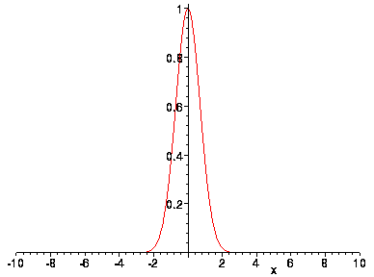
Gaussian Activation Function
it is essentially zero everywhere except in a small region around zero.

Slide 52
Multiclass classification –
classification task with more than two classes.
model is to predict one possible class output every time.
Multiclass classification assumption :
each image/sample is assigned to one and only one label - one sample cannot, for example, be both an orange and an apple.

Slide 53
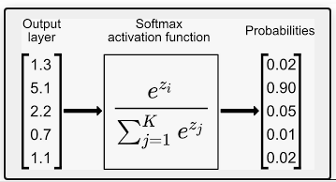
SOFTMAX FUNCTION
Softmax is applied to the last layer in a neural network, to get probabilities for different classes in the output

Slide 54
The Softmax is meant to be a ”softer”, less binary (less all-or-nothing- Hardmax function).
Softmax makes sure that one value is very high (close to 1) and all other values are very low (close to 0).
Sum of all the individual probabilities must be equal to one

Slide 55
Softmax can be used for any number of classes.
It's also used for hundreds and thousands of classes, in object recognition problems where there are hundreds of different possible objects.
This function ensures that all the output nodes have values between 0–1 and the sum of all output node values equals to 1 always.

Slide 56
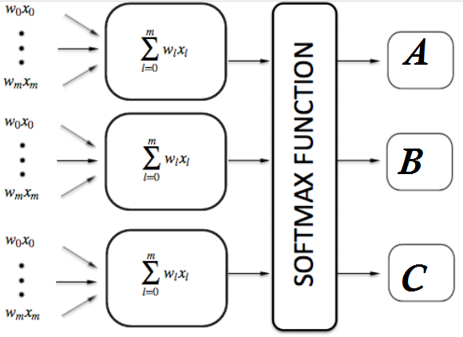

Slide 57
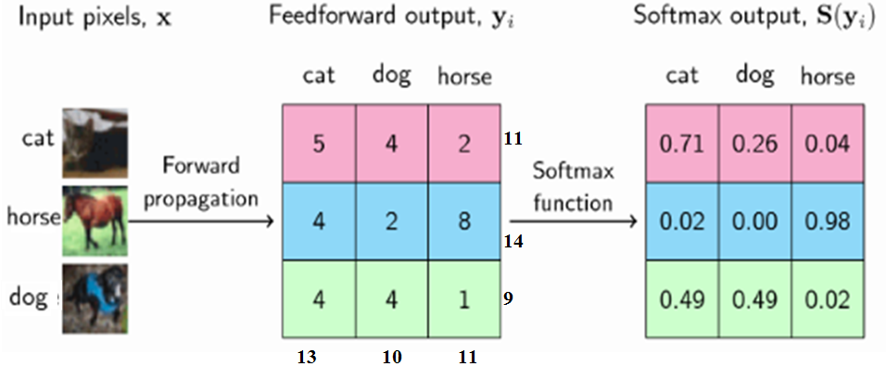
Output of Softmax describes the probability/confidence of a neural network that a particular sample belongs to a certain class.

Slide 58
Multiple Class, Multiple Label Classification
Classify tweets in natural disaster related classes like
1. Emergency
2. Food Shortage
3. Medical Emergency
4. Water Shortage
5. People Stuck
Single tweet can belong to multiple classes

Slide 59
Softmax OR Sigmoid in multi-label
Softmax can’t be used as the sum of the probabilities in multi-label case doesn’t add to one, each class probability is between 0 and 1
A sigmoid function is used as there may be multiple labels that have high probabilities for a given data item.
This is a common mistake even with experienced practitioners.

Slide 60
NEURAL NETWORK ARCHITECTURES

Slide 61
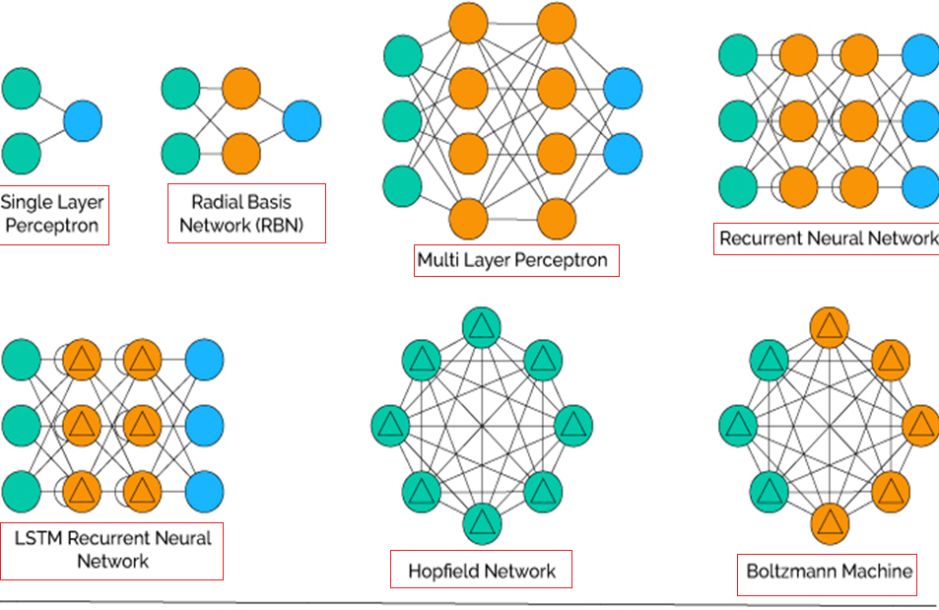

Slide 62
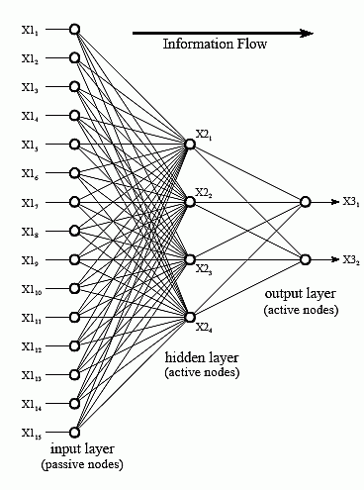
Neural Network Architecture
The nodes of the input layer are passive, meaning they do not modify the data.
the nodes of the hidden and output layer are active.

Slide 63
Setting number of layers and their sizes
Should we use no hidden layers?
One hidden layer?
Two hidden layers?
How large should each layer be?
As the size and number of layers in a Neural Network are increased, space of represent able functions grows since the neurons can collaborate to express many different functions.

Slide 64
How many hidden layers?
Usually just one (i.e., a 2-layer net)
How many hidden units(neurons) in the layer?
Too few ==> can’t learn
Too many ==> poor generalization

Slide 65
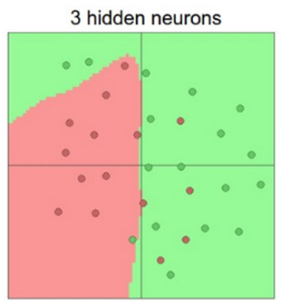
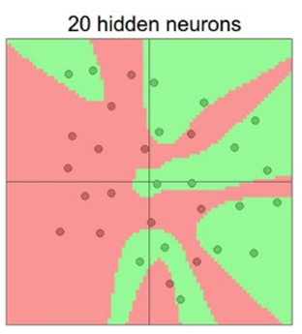
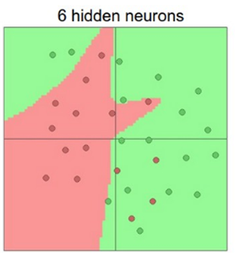
suppose we had a binary classification problem in two dimensions. We could train three separate neural networks, each with one hidden layer of different number of neurons and obtain the following classifiers:

Slide 66
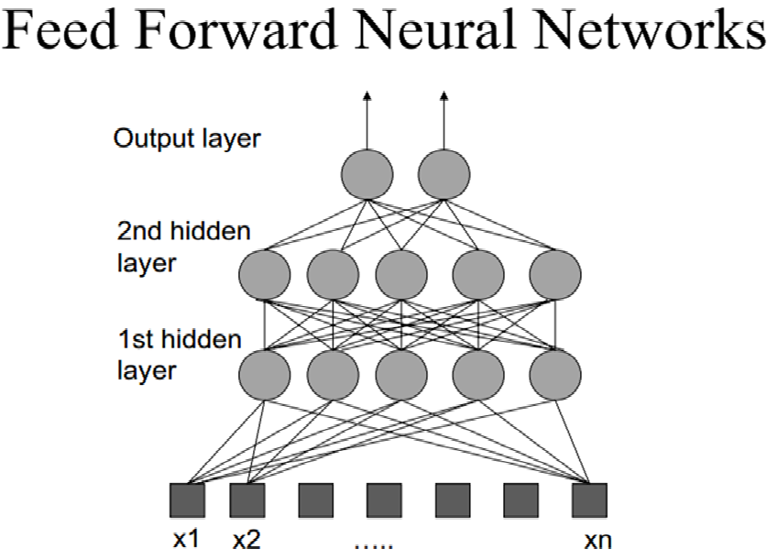
The feedforward neural network was the first and simplest type of ANN.
In this network, the information moves in only one direction—forward—from the input nodes, through the hidden nodes (if any) and to the output nodes.
There are no cycles or loops in the network.

Slide 67


Slide 68
Each pixel takes a value between 0 and 255 (RGB color code).
0 means the color is white and 255 means the color black.
dissect the image (28x28) into an array of 784 numbers like [0, 0, 180, 16, 230, …, 4, 77, 0, 0, 0], and feed this array into neural network
B&W image means pixel value can be 0/1

Slide 69


Slide 70
The 10 output neurons,each represents yes/no for a digit from 0 to 9.
If the neural network thinks the handwritten digit is a zero, then we should get an output array of
[1, 0, 0, 0, 0, 0, 0, 0, 0, 0],
If the neural network thinks the handwritten digit is a 5, then we should get
[0, 0, 0, 0, 0, 1, 0, 0, 0, 0].
Single high (1) bit and all the others low (0) ONE HOT REPRESENTATION

Slide 71


Slide 72

Express inputs outputs in matrix form
WX = Z

Slide 74


Slide 75

Calculate output of Node A, B & Z,
logsigmoid is the activation function

Slide 76

Calculate output of Node A, B & Z

Slide 77


Slide 78

Calculate output of Node A, B & Z

Slide 79

How many parameters with/without biases ??
[3 x 4] + [4 x 4] + [4 x 1] = 12 + 16 + 4 = 32 weights without bias
and 4 + 4 + 1 = 9 biases,
total of 41 learnable parameters with biases.

Slide 80
total learnable parameters with biases.
[786x16] + [16x10] + [16] +[10] =12,762

Slide 81



FEEDBACK/RECURRENT NETWORKS

